Slide 1
Odoo installation guide
Pham Duc Thang

Slide 2
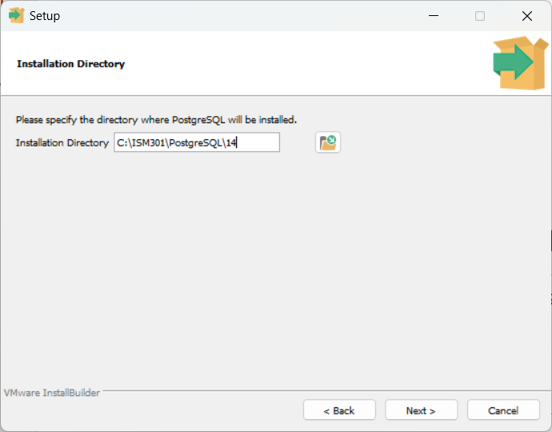
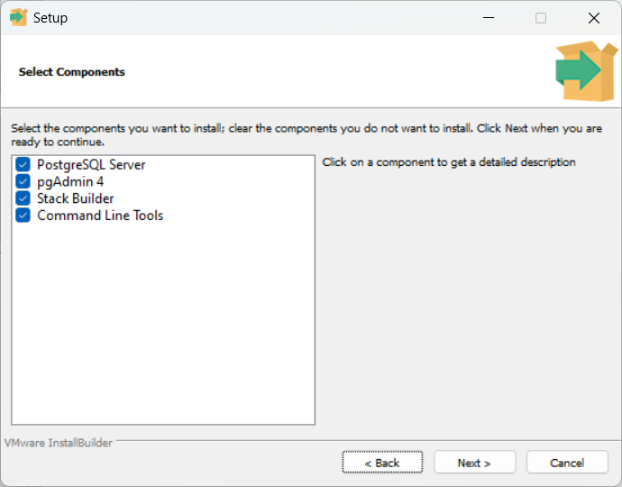
1. Install PostgreSQL 14
Select all

Slide 3

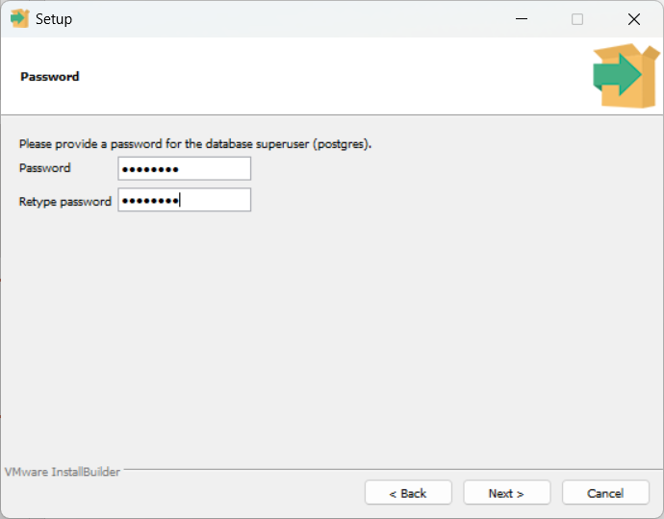
Install PostgreSQL 14
Choose installation folder
Set a password for DB superuser

Slide 4
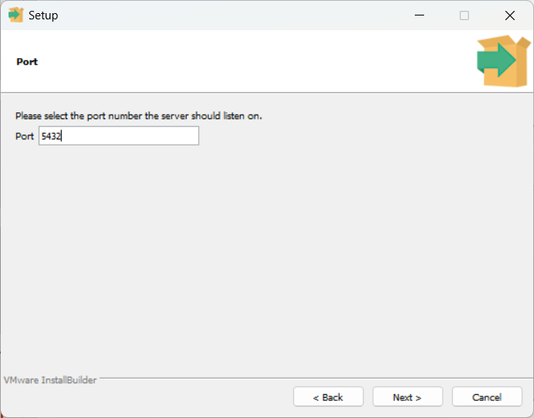
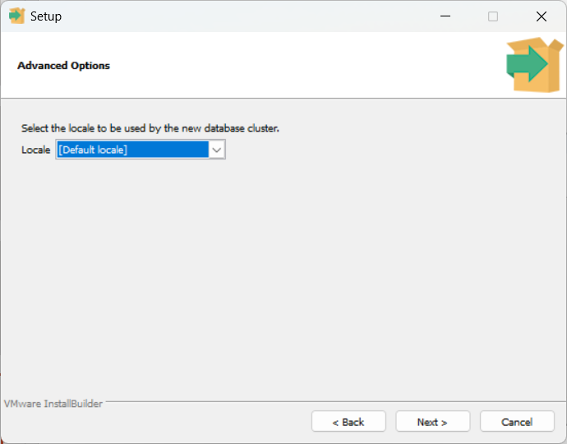
Install PostgreSQL 14
Choose default port number

Slide 5
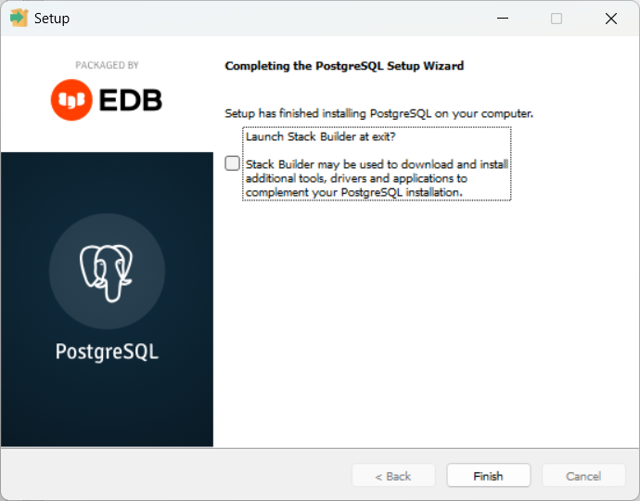
Install PostgreSQL 14

Slide 6
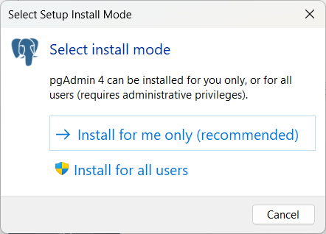
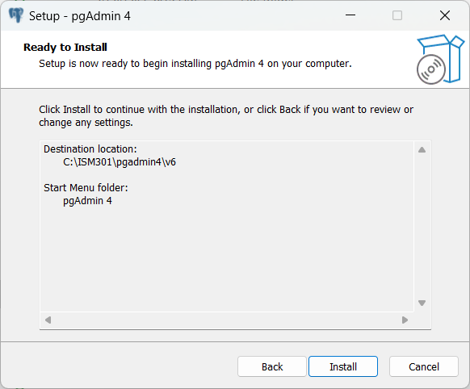
2. Install Pgadmin4 6.13

Slide 7
Install Pgadmin4 6.13

Slide 8
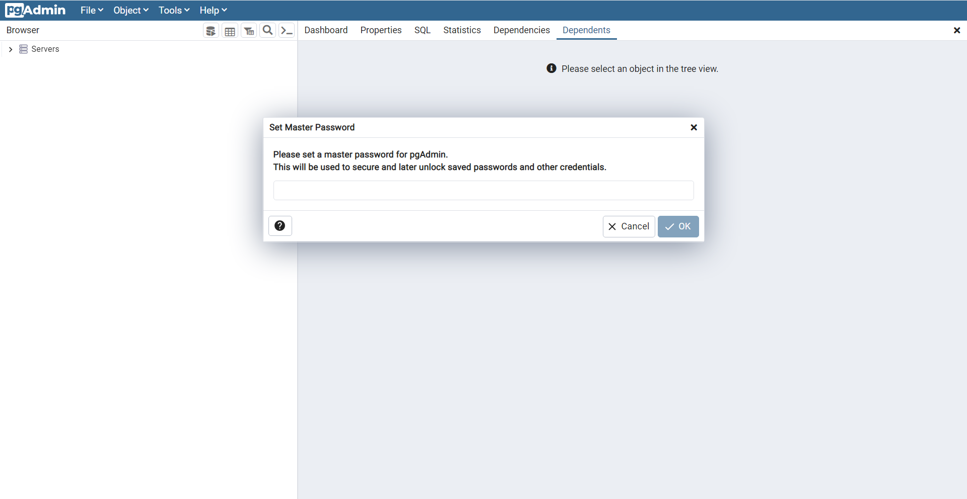
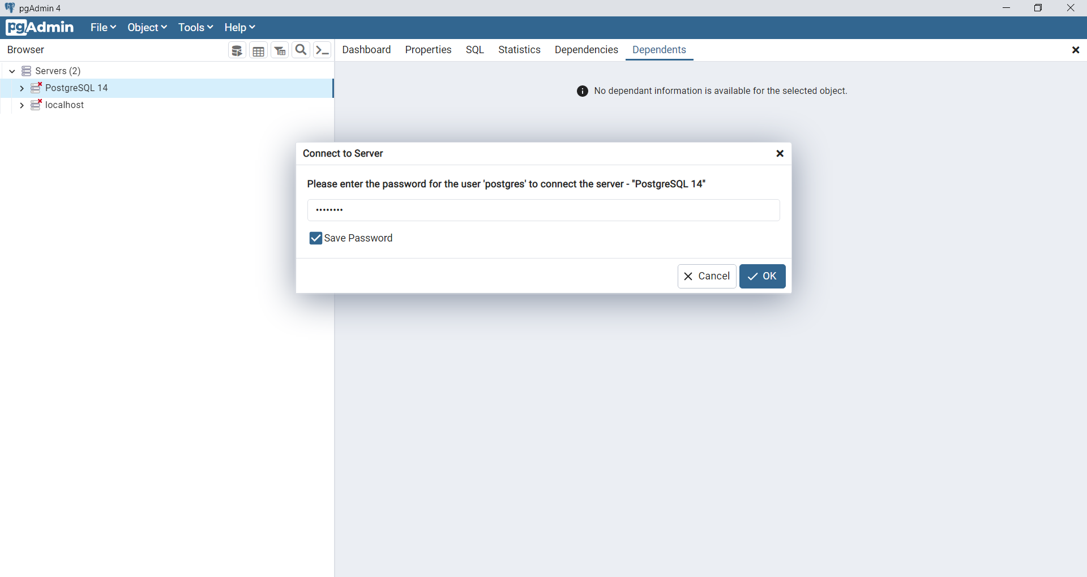
Run Pgadmin4
Set master password like “12345678”
Connect to PostgreSQL14 using super admin account

Slide 9
Run Pgadmin4
Set master password like “12345678”
Connect to PostgreSQL14 using super admin account

Slide 10
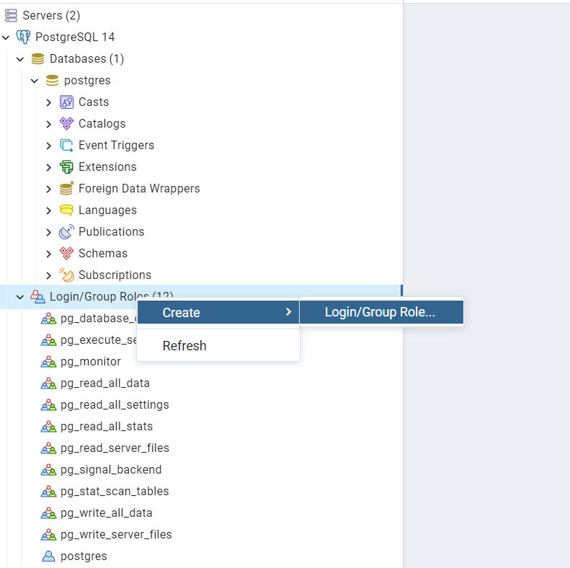
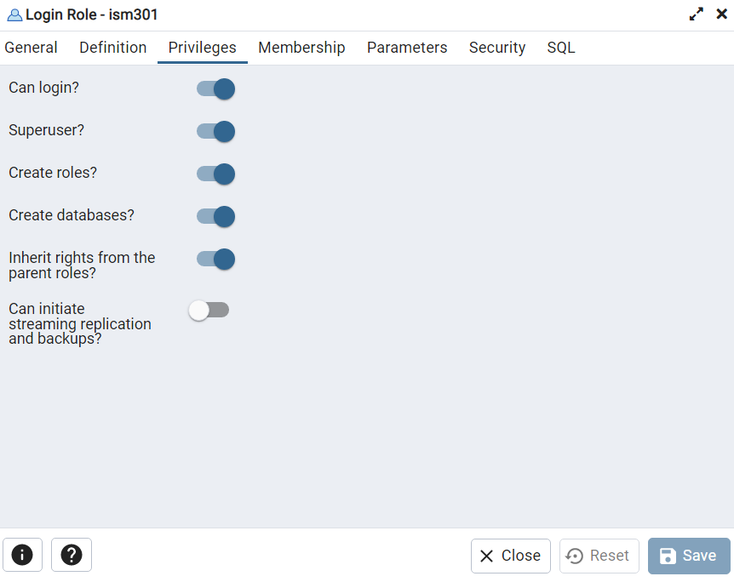
Run Pgadmin4
Create account for Odoo
Tab General: Key-in account name like “ism301”
Tab Definition: Key-in password like “12345678”
Tab Privileges: enable can login; superuser role
Then Save

Slide 11
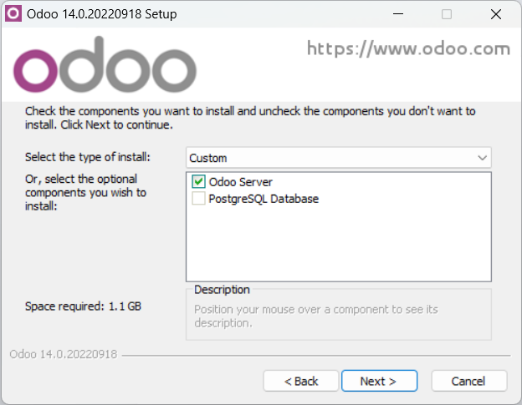
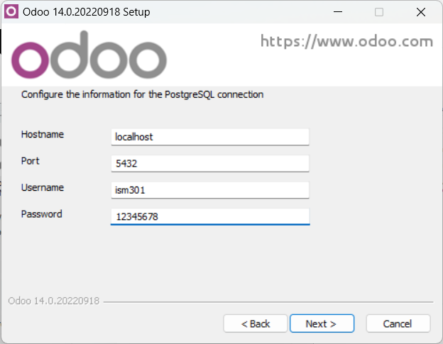
3. Install Odoo v14
Install Odoo 14 community edition without PostgreSQL DB
Config PostgreSQL connection using the created account/password

Slide 12
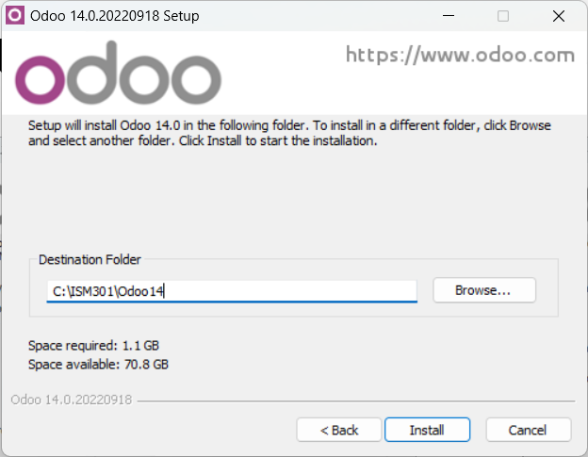
Install Odoo v14
Choose destination folder
Config PostgreSQL connection using the created account/password

Slide 13
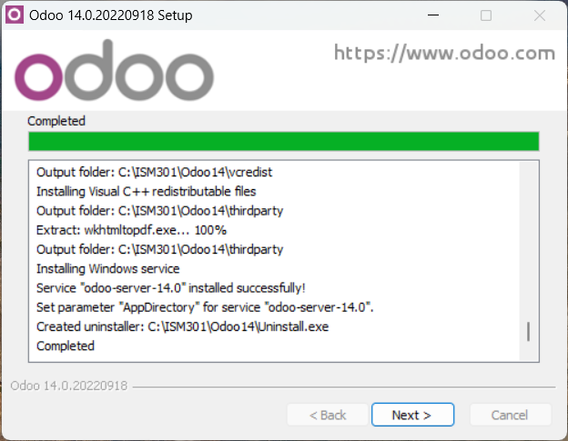
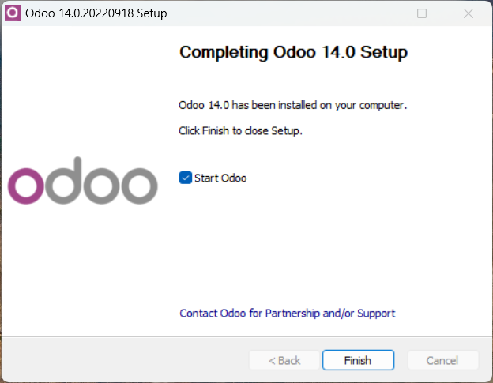
Install Odoo v14

Slide 14
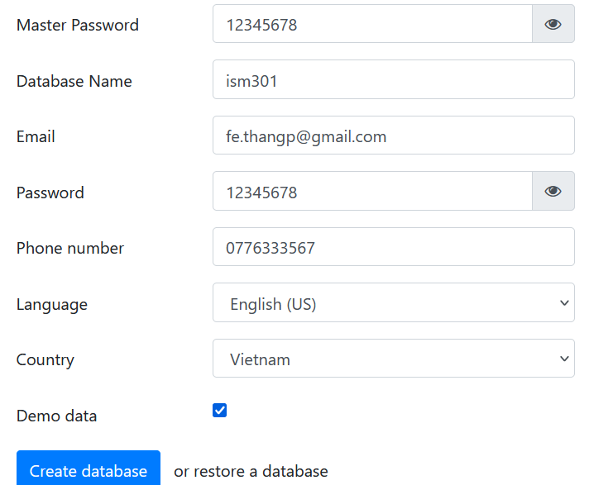
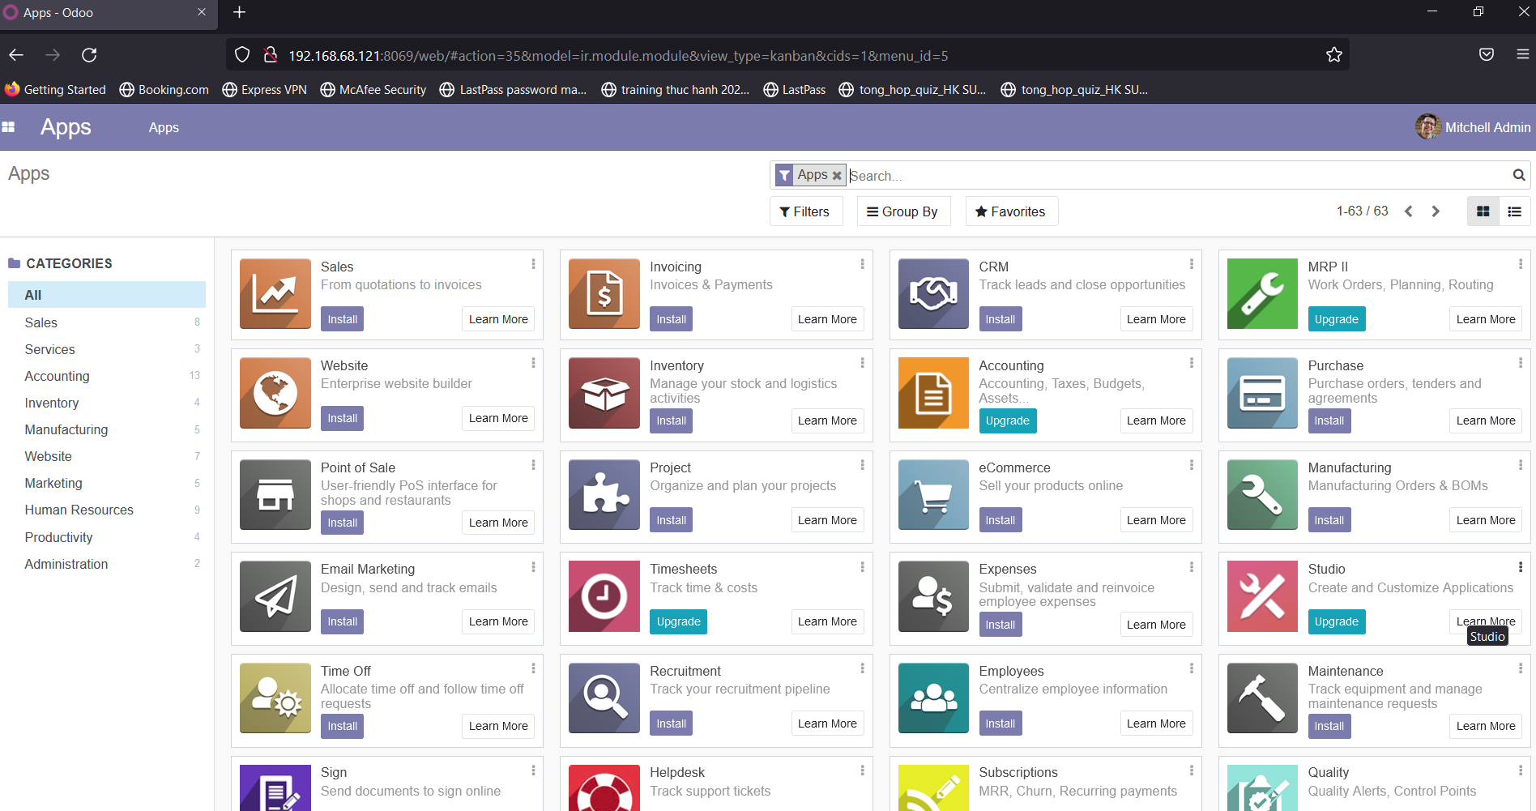
Install Odoo v14

